Slide 1
Glasgow Museums Online
How can you access our collections now?
Online catalogue
Podcasts
YouTube
Photo Library
ArtUK
Smartify
Social media
… and we are working to improve things and add more …

Slide 2
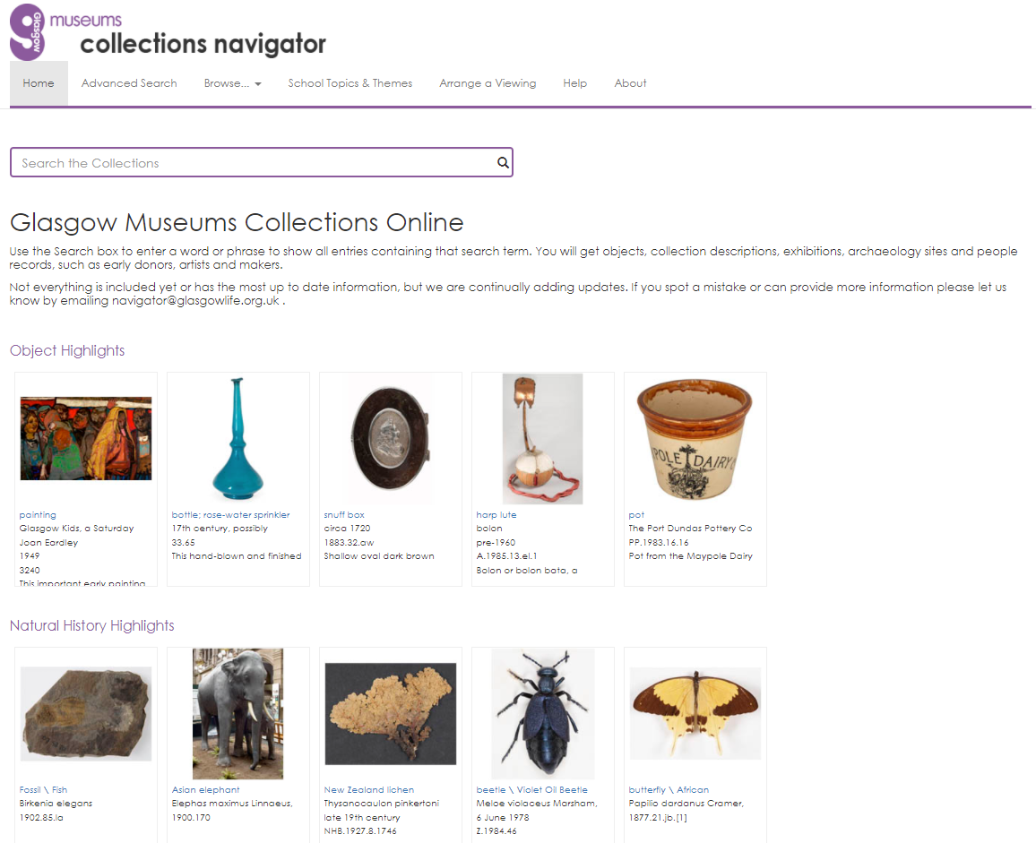
Collections Navigator – our online catalogue http://collections.glasgowmuseums.com

Slide 3
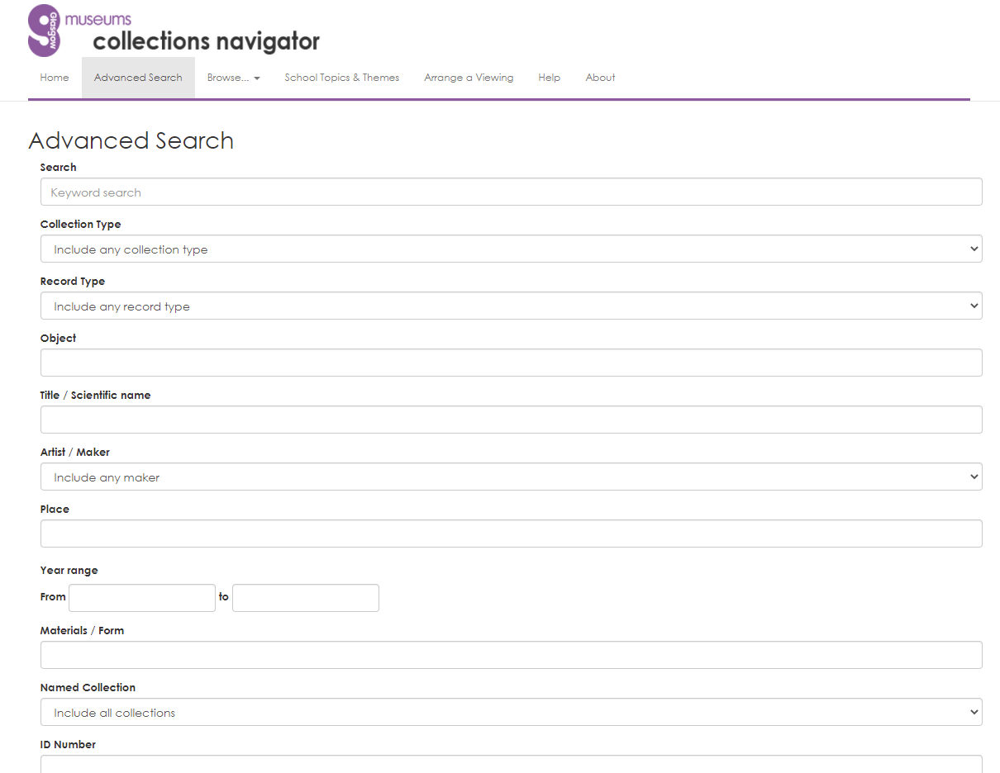
Search by key word or do an advanced search

Slide 4
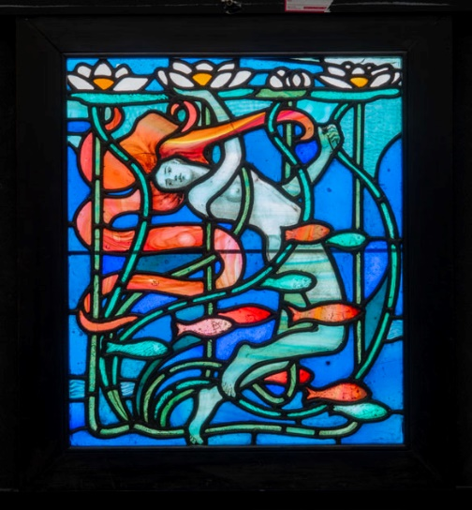
What do you get?
PP.1981.29, Leaded-glass panel titled ‘Water Sprite’, designed by William Gibson Morton

Slide 5
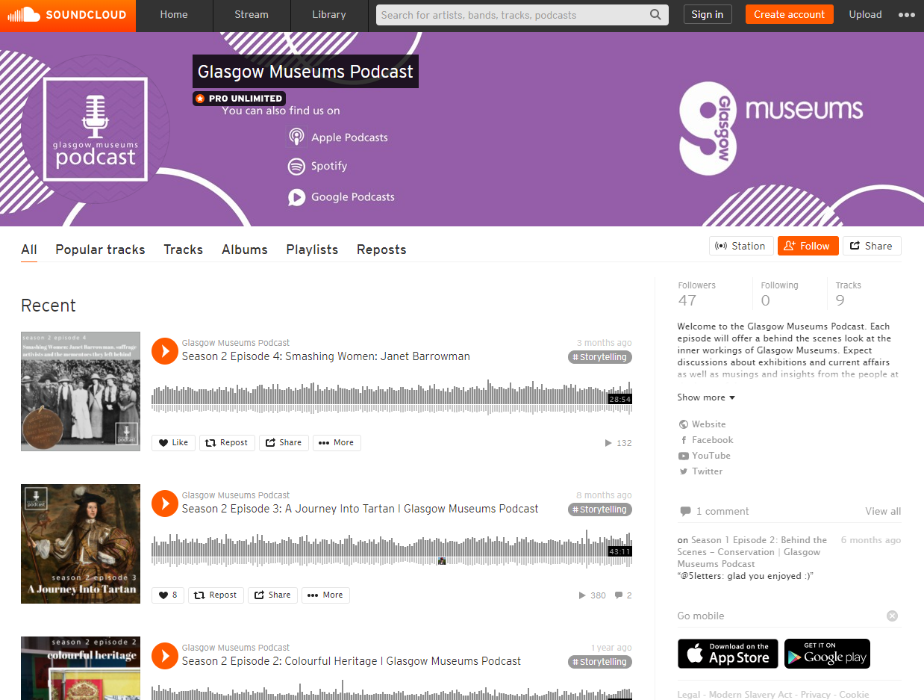
Podcasts https://soundcloud.com/glasgowmuseums

Slide 6
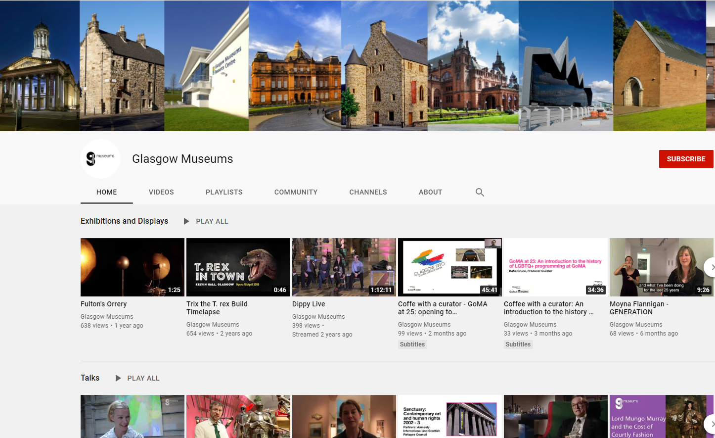
YouTube https://www.youtube.com/user/glasgowmuseums

Slide 7
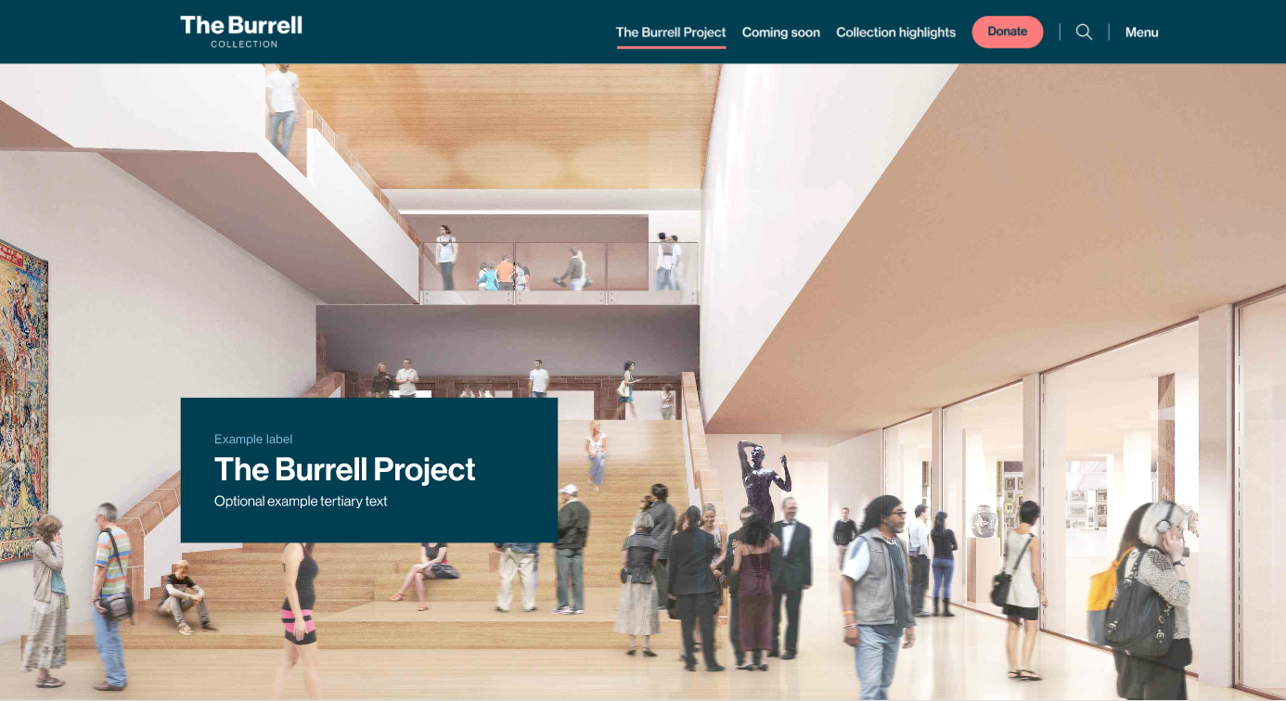
Burrell website

Slide 8
Photo Library http://www.csgimages.org.uk/indexplus/page/Home.html

Slide 9
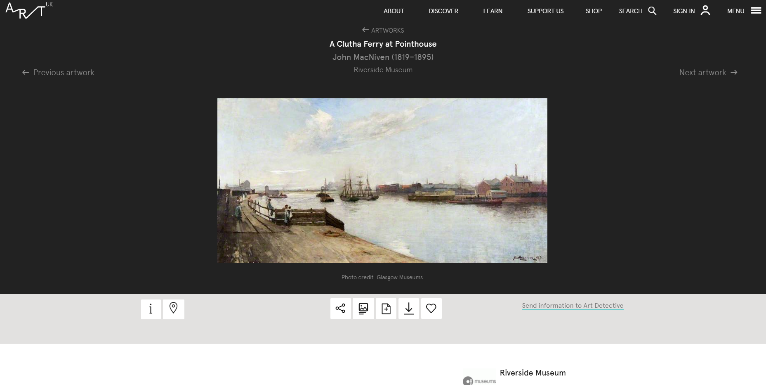
Art UK https://artuk.org/visit/collection/glasgow-museums-568

Slide 10
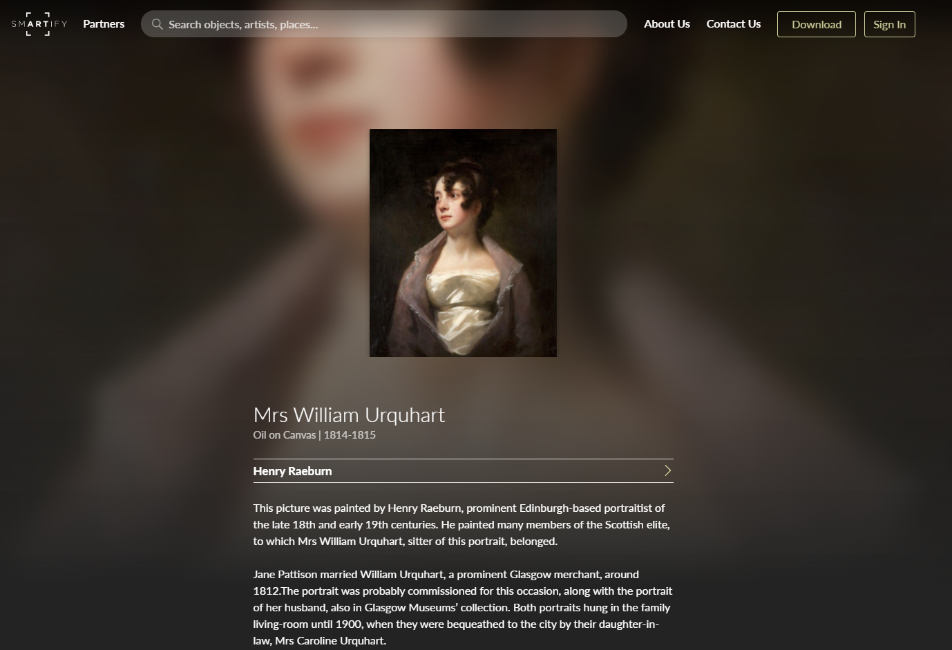
Smartify https://smartify.org/venues/kelvingrove-art-gallery-and-museum

Slide 11
Other digital offers
Social media
Facebook
Twitter
Instagram
Websites
Small standalone online exhibitions being developed, e.g. for COP26
Blogs – Burrell, GOMA, Friends of Glasgow Museums, Legacies of Slavery

