Slide 1
JAN PIETERSZOON SWEELINCK
‘A’ Level Music Resources from The Open University

Slide 2
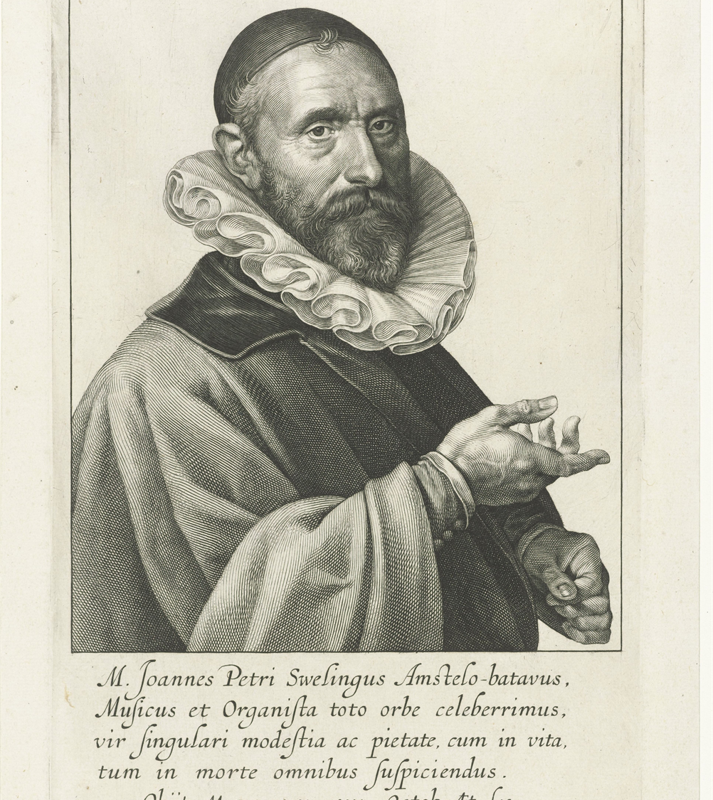
01
Oude Kerk, Amsterdam
02
Oude Kerk organs
03
Sweelinck’s grave and memorial
Notes:
"File:Portret van Jan Pieterszoon Sweelinck, RP-P-OB-32.133.jpg" by Rijksmuseum is licensed under CC0 1.0

Slide 3
Oude Kerk, Amsterdam

Slide 4
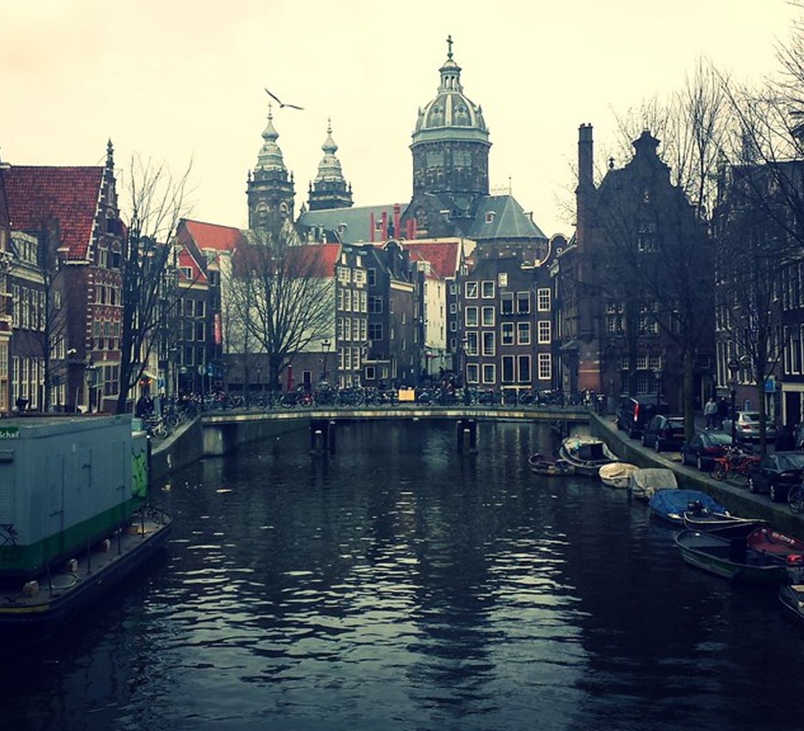
Notes:
"Old Church" by ~MVI~ (warped) is licensed under CC BY-NC 2.0

Slide 5
Notes:
"Oude KERK" by Eoghan OLionnain is licensed under CC BY-SA 2.0

Slide 7
Oude Kerk organs

Slide 8
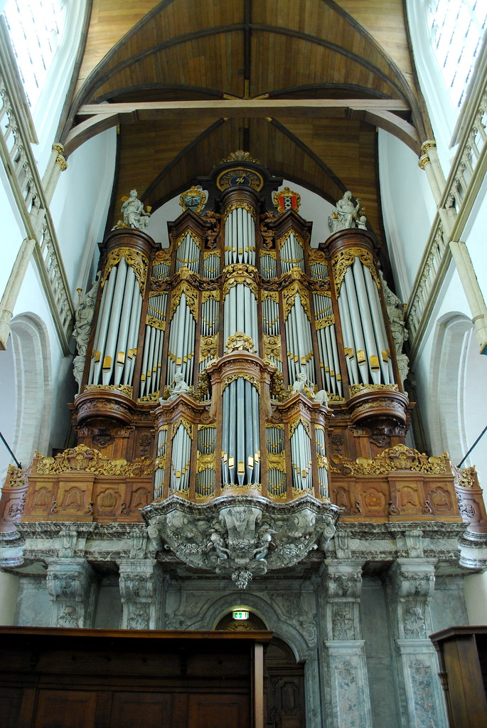
Notes:
"Oude Organ" by kevingessner is licensed under CC BY 2.0

Slide 9
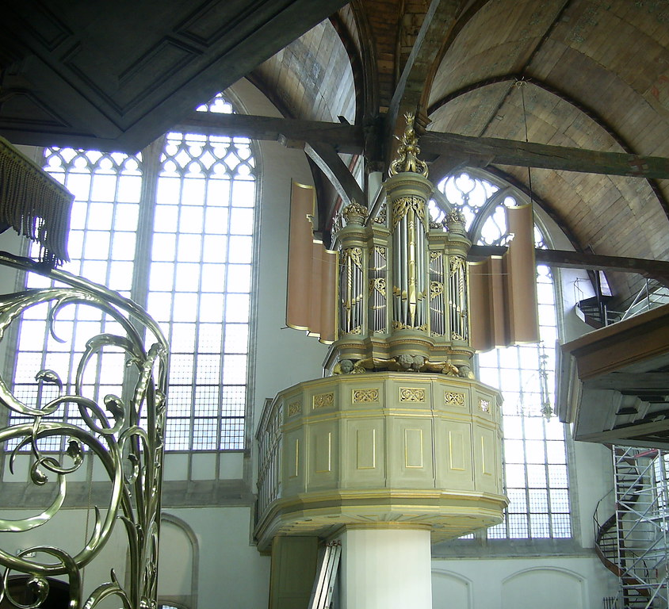
Notes:
"Small Organ" by philbelb is licensed under CC BY-NC 2.0

Slide 10
Sweelinck’s grave and memorial at Oude Kerk

Slide 11
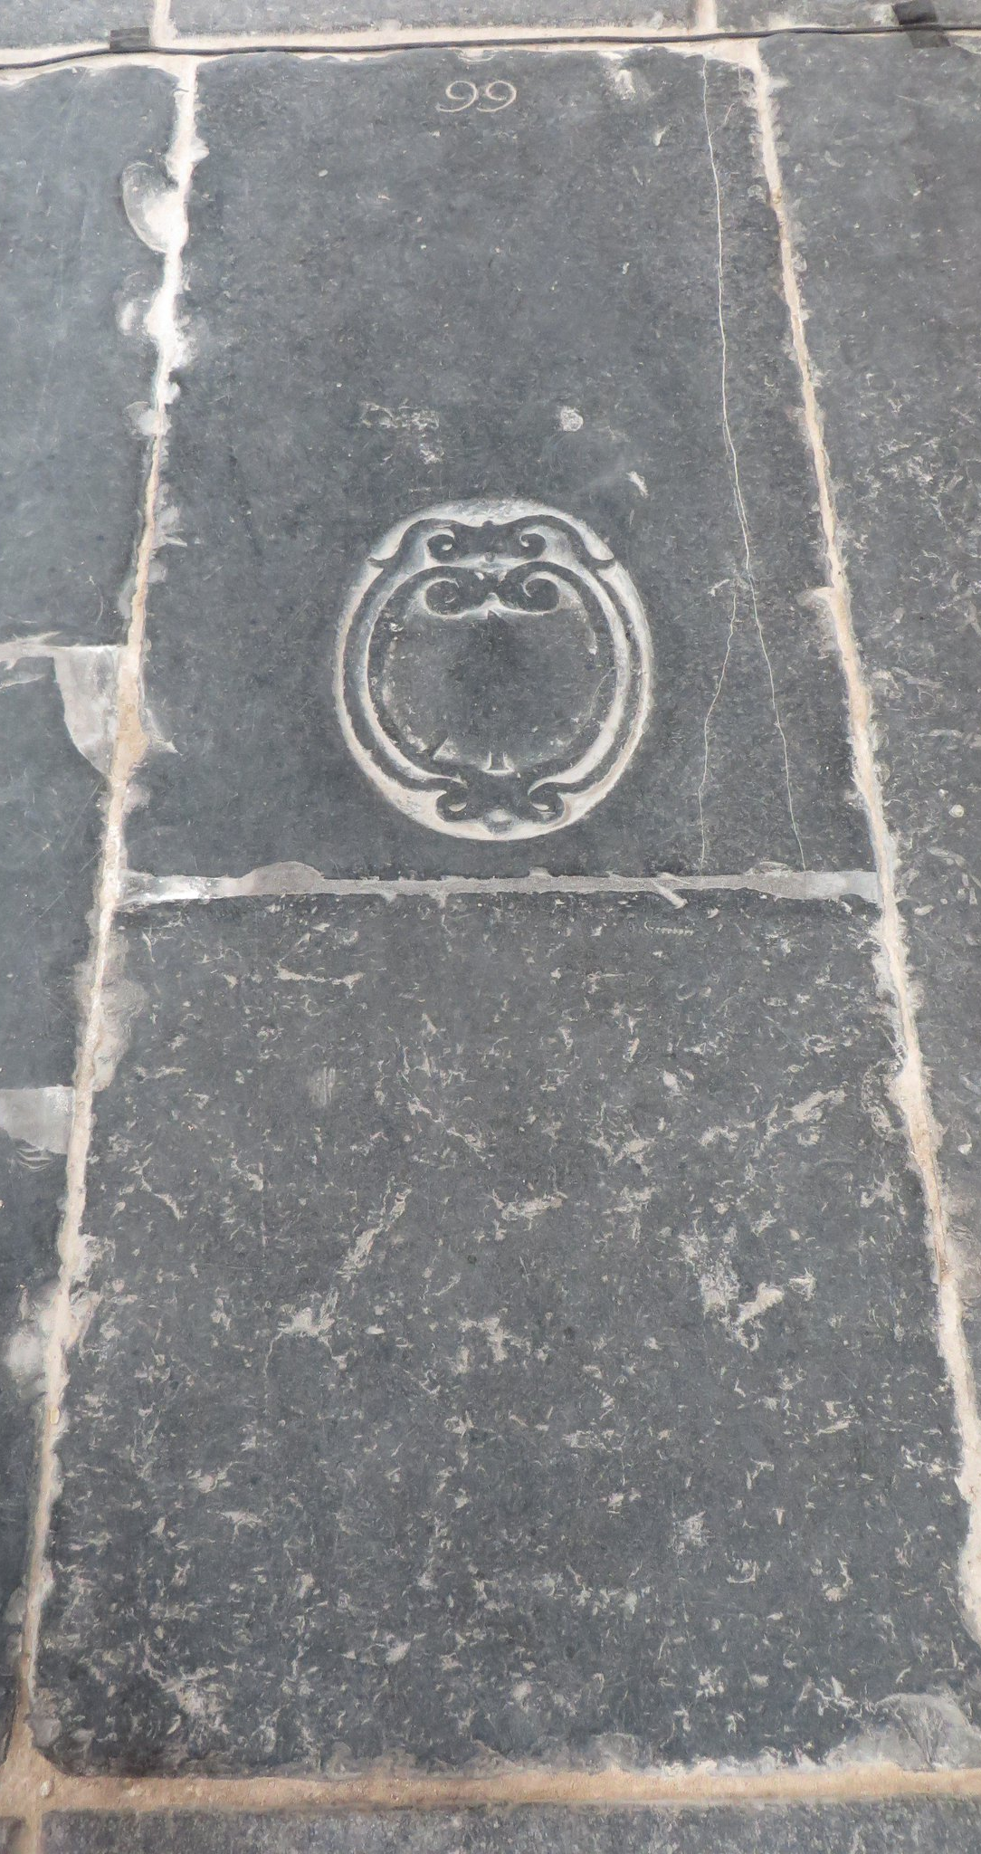

Slide 12
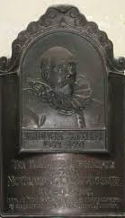

Slide 13
For more information on Music at The Open University, visit fass.open.ac.uk/music

