Slide 1
Music at the Ospedale della Pietà
‘A’ Level Music Resources from The Open University

Slide 2
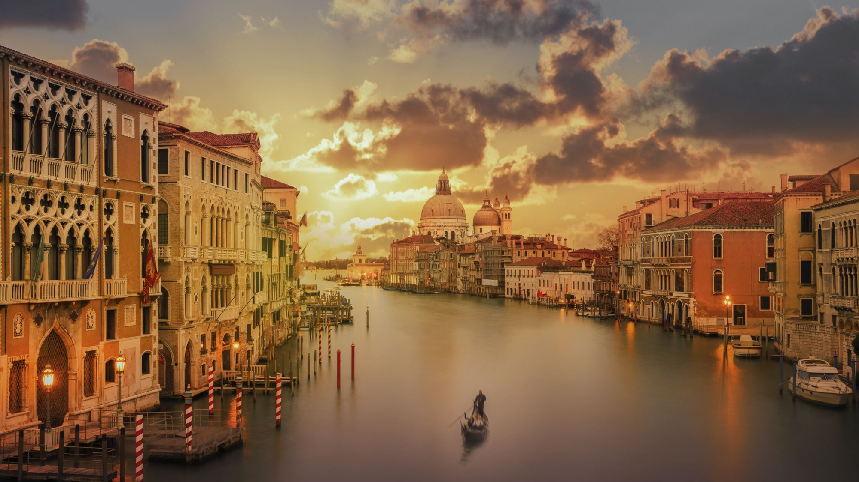
18th century Venice
The Venetian environment
A city ‘replete with things, not only those that are necessary for living, but also those needed for enjoying life’

Slide 3
The Ospedali grandi
Ospedale degl’Incurabili (1522)
  Originally for syphilitics, expanded to include home for reformed prostitutes, an orphanage and school for girls of the impoverished noble and citizen classes
Ospedale della Pietà (1336)
  Home for abandoned babies, care could extend for a lifetime
Ospedale di Santa Maria dei derelitti ai Santi Giovanni e Paulo (1528)
  Founded as a home for street children
Ospedale di San Lazaro e dei Mendicanti (1182, re-founded 1595)
  Founded as a refuge for crusaders, became the first leper colony

Slide 4
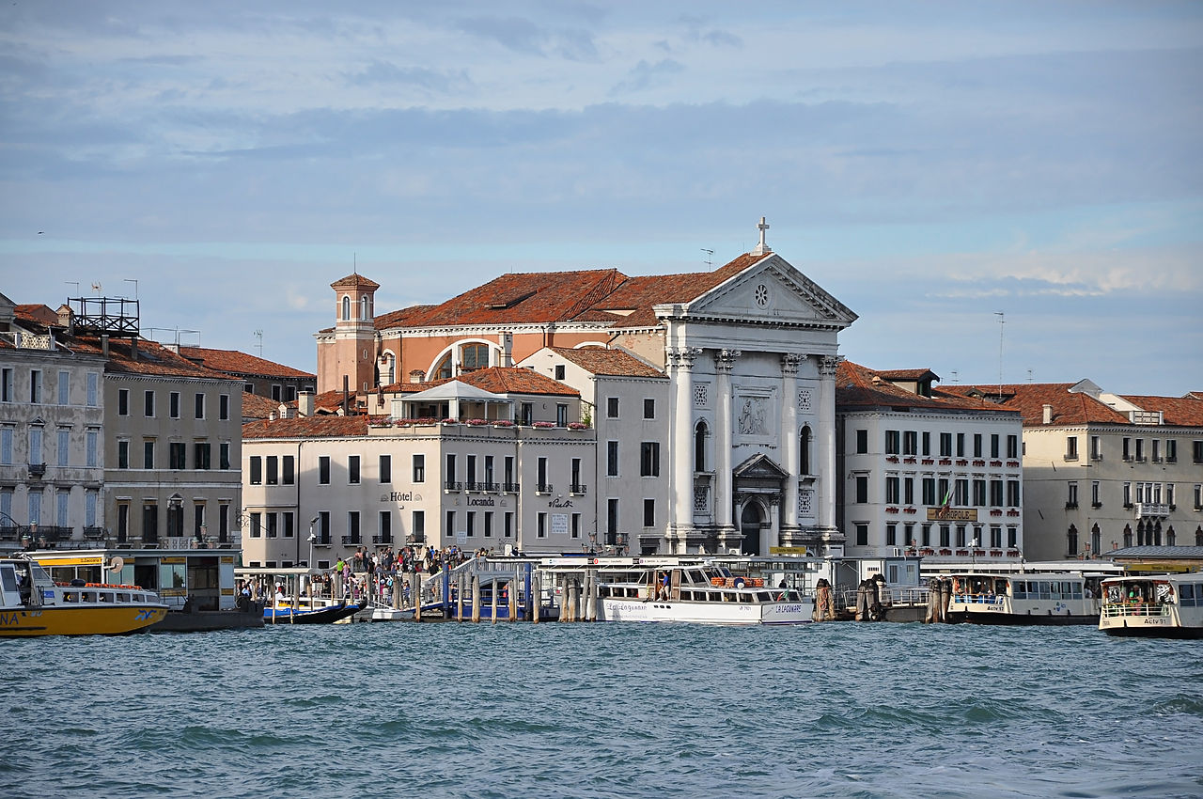
The Ospedale della Pietà
This Photo by Unknown Author is licensed under CC BY-SA

Slide 5
Typical daily routine of monastic hours
Activity | Time
Get up | Sunrise
Matins | 07:00
Mass | 07:30
Prime | 08:00
Work
Terce | 09:20
Work
Sext | 10:40
Dinner | 11:00
Rest
None | 14:00
Work
Vespers | 18:00
Supper | 18:45
Compline | 19:30
Bed | 20:00

Slide 6
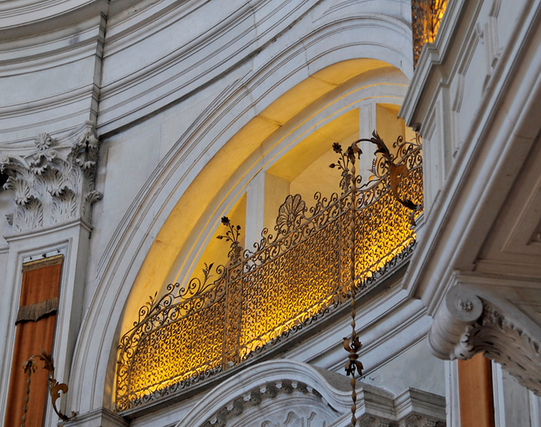
Ospedale della Pietà
Cantoria or choir loft where the musicians would perform out of sight behind grills

Slide 7
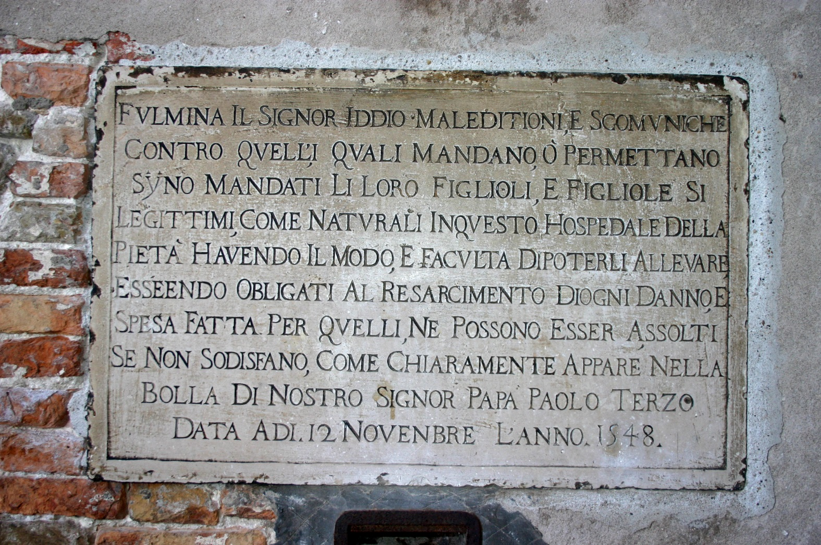
Ospedale della Pietà
The plaque above the ‘wheel’ in which babies could be left in the care of the Ospedale warning of the wrath of God to those who abandon children either legitimate or illegitimate, if they have the means to support them.

Slide 8
For more information on Music at
The Open University, visit fass.open.ac.uk/music

