Slide 1
Vivaldi: ‘Il gardellino’ and the concerto in Venic
‘A’ Level Music Resources from The Open University

Slide 2
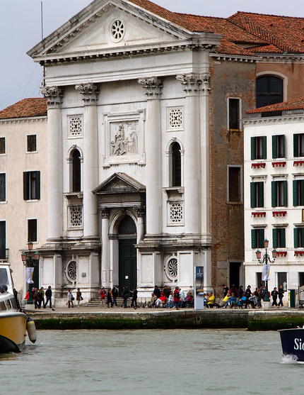
01
Ritornello Structure
02
Compositional techniques
03
Sweelinck’s grave and memorial
This Photo by Unknown Author is licensed under CC BY
Notes:
"File:Portret van Jan Pieterszoon Sweelinck, RP-P-OB-32.133.jpg" by Rijksmuseum is licensed under CC0 1.0

Slide 3
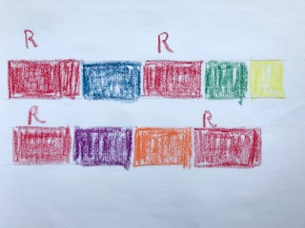
Ritornello Structure
Simple graphic representation of the first movement of ‘Il cardellino’
Boxes of different colours represent the ritornello and episodes
Ritornellos are red

Slide 4
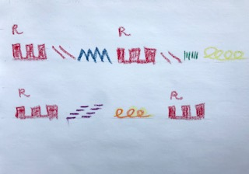
Ritornello Structure
Graphic representation of the first movement of ‘Il cardellino’
Red sections represent the ritornello, showing its two constituent parts
Episodes are the different colours
Different patterns indicate different musical material

Slide 5
Compositional techniques

Slide 6
Identify the compositional techniques in the following bars of the first movement of ‘Il gardellino’
bars | Compositional technique
5-7 flute
5-8² complete texture
21-24²
32-33
65-68¹
80³-85¹

Slide 7
bars | Compositional technique
5-7 flute | sequence (the outlined chords follow the melody in moving from G major – f sharp minor – e minor)
5-8² complete texture | Harmonic sequence (D-G-C#-F#-B-E-A-D) I-IV-vii-iii-vi-ii-V-I Note from b.6 this is also a circle of fifths, but the tonicisations are implied as the chordal third and fifth are missing from the texture in which a single line accompaniment is doubled at the octave
21-24² | Two-bar repetition. Although this looks like a sequence it isn’t as the interval pattern in the accompaniment is different
32-33 | Melodic sequence bar 32, but this is a simple repetition in bar 33
65-68¹ | Sequence in solo part but harmonic sequence is disrupted at 67 to modulate from B min back to tonic (D maj)
80³-85¹ | Nested harmonic sequence around a circle of fifths (80³⁻82² pattern 82³-83 sequence) (E min- A maj-D maj-G maj / C# min-F# min-B min) final sequence to 85 is truncated to reach the tonic (E min-A maj-D maj)

Slide 8
For more information on Music at The Open University, visit fass.open.ac.uk/music

