Slide 1
CLARA SCHUMANN
‘A’ Level Music Resources from The Open University

Slide 2
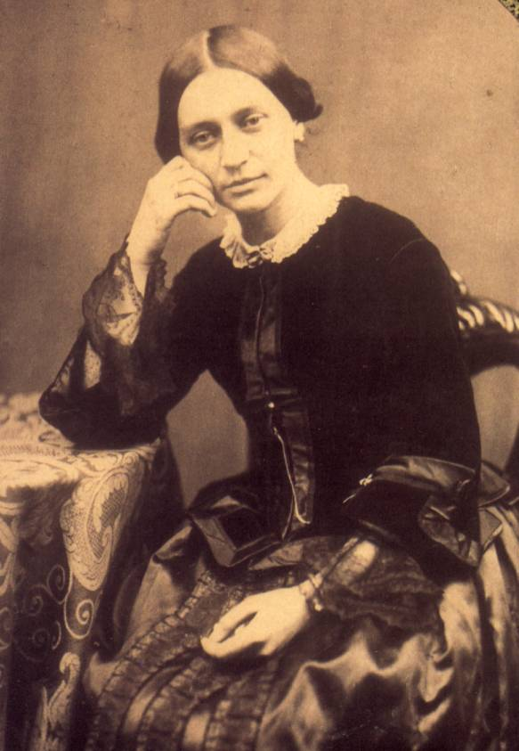
01
Clara Schumann’s Leipzig
02
Clara Wieck, Friedrich Wieck, Robert Schumann (Contemporary Drawings and Photos)
03
A Musical Marriage
Clara Schumann (1819-1896)
Notes:
"File:Portret van Jan Pieterszoon Sweelinck, RP-P-OB-32.133.jpg" by Rijksmuseum is licensed under CC0 1.0

Slide 3
Clara Schumann’s Leipzig

Slide 4
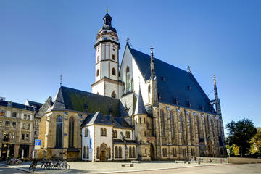
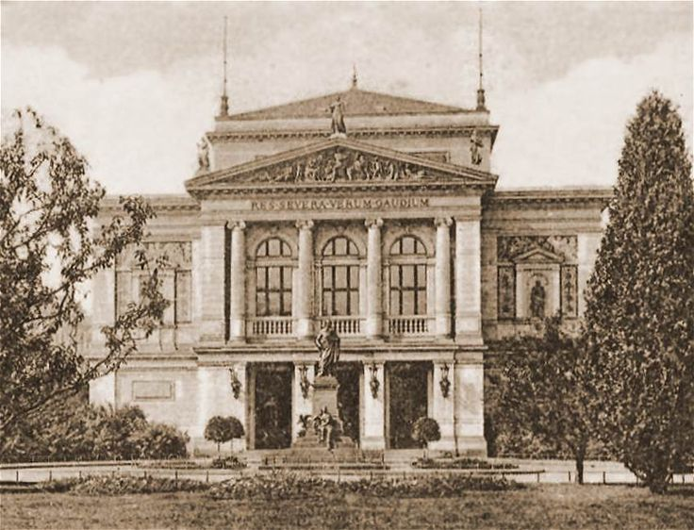
Leipzig
Gewandhaus Concert House
St Thomas’s Church

Slide 5
Clara Wieck, Friedrich Wieck, Robert Schumann (Contemporary Drawings and Photos)

Slide 6
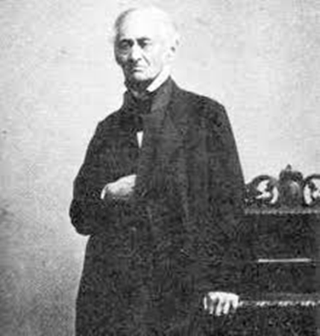
Friedrich Wieck (1785-1873)

Slide 7
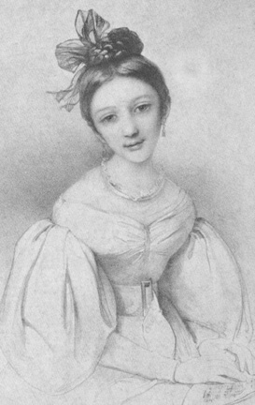
Clara Wieck (1832)
Clara Wieck (1832)

Slide 8
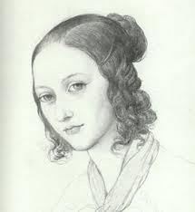
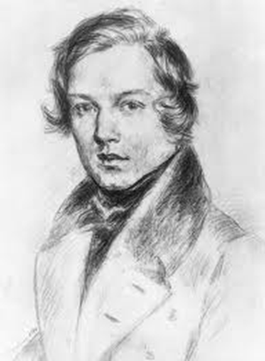
Tug of Love
Friedrich
Wieck
Clara
Wieck
Robert
Schumann

Slide 9
A Musical Marriage

Slide 10
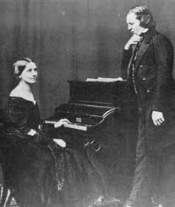
A Musical Marriage
Clara and Robert Schumann (c.1850)

Slide 11
‘My piano playing again falls completely by the wayside, as is always the case when Robert composes. Not a single little hour can be found for me the entire day! If only I don’t regress too much!’
Clara Schumann, entry in the Schumanns’ Marriage Diary (2 June 1841)

Slide 12
‘The first year of our marriage you shall forget the artist, you shall live only for yourself and your house and your husband, and wait… just see how I will make you forget the artist – because the wife stands even higher than the artist and only if I achieve this much – that you have nothing more to do with the public – I will have achieved my deepest wish. Yet you still remain an artist. The bit of fame in the contemptible paper that your father considers the greatest happiness in the world – I despise it.’
Robert Schumann, letter to Clara Wieck, early 1839 (the year before their marriage)

Slide 13
Laura Hamer, ‘Clara Schumann’, a short film to mark the bicentenary of Clara Schumann’s birth (in 2019), produced by The Open University: https://www.youtube.com/watch?v=gtWFgZ2pbU8

Slide 14
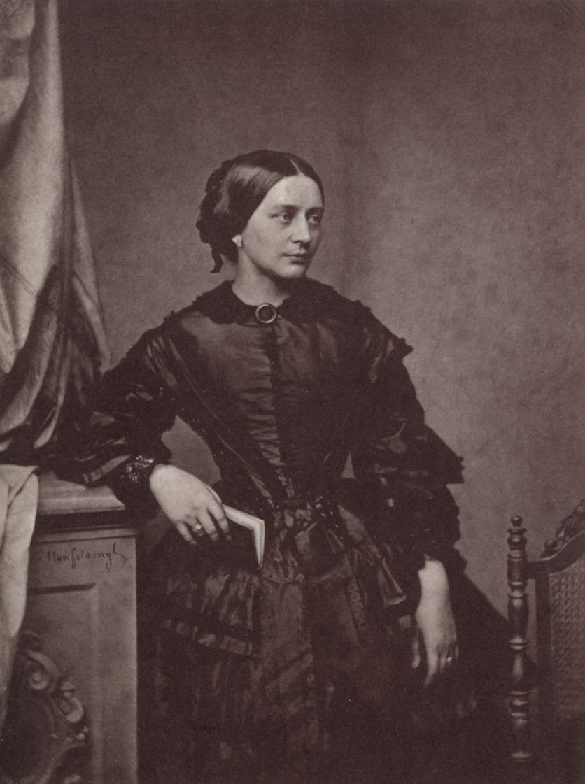

Slide 15
For more information on Music at
The Open University, visit fass.open.ac.uk/music

