Slide 1
Trust in Forensic Science Evidence in the Criminal Justice System: The Experience of Marginalised Groups
Presented by
Dr Violeta Kapageorgiadou
Dr Clair Dempsey

Slide 2
Agenda
The team
The project
Findings
Survey
Linguistic survey
Interviews
Focus groups

Slide 3
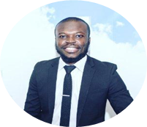
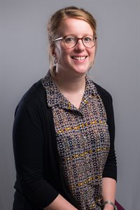
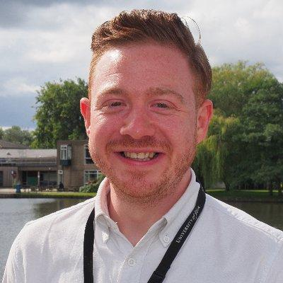
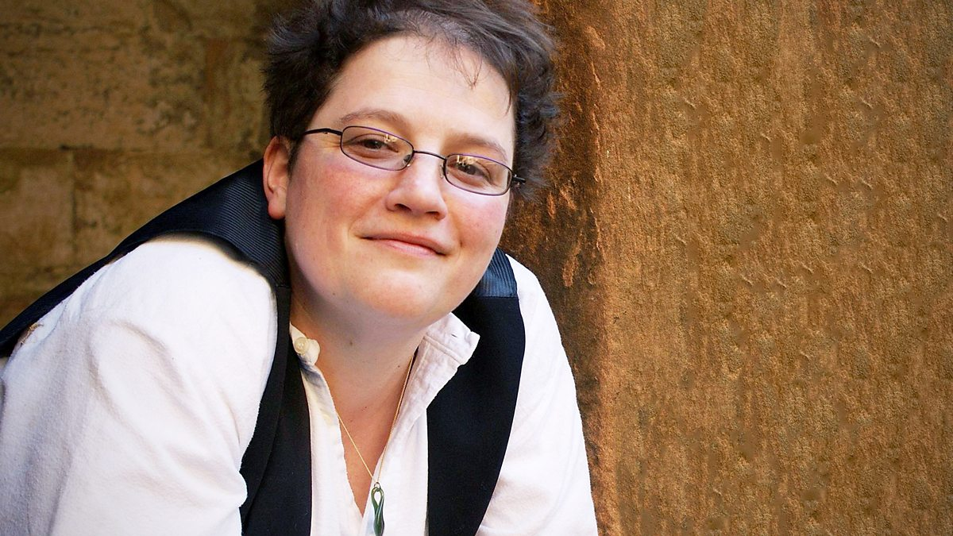
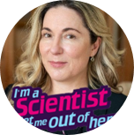
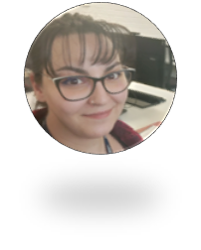
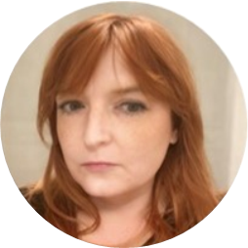
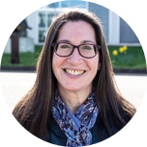
The team
The team
Dr Emmanuel Nsiah Amoako
Dr Emma Johnston
De Montfort University
Forensic Evi.; Marginalised Groups
Co- Investigator
Dr Vincent Hughes
University of York
Forensic Speech Science
Co- Investigator
Dr Maria Maclennan
University of Edinburgh
User-Centred Design
Co- Investigator
Professor Niamh Nic Daeid
University of Dundee
Forensic Evi.; Public Engagement
Co- Investigator
UWE Bristol
Forensic Evi.; Criminal Justice
Co-Investigator
Professor Heather Flowe
University of Birmingham
Psychology; Decision-Making
Co- Investigator
Dr Violeta Kapageorgiadou
The Open University
Criminal Justice.; Marginalised Groups
PDRA
Dr Clair Dempsey
The Open University
User Design, Psychology, PDRA
Professor Lara Frumkin
The Open University
Psychology; Marginalised CJS Users
Principal Investigator

Slide 4
The project
Research Questions:
- Q1 How does existing CJS use of forensic science evidence affect trust and yield challenges for marginalised users?
- Q2 What are the theoretical, practice, and policy implications of trust perceptions surrounding forensic science evidence (namely, DNA and digital evidence)?
- Q3 What impact does (dis)trust of forensic science evidence (DNA and digital) have on how marginalised users experience the CJS?
- Q4 How can distrust of forensic science evidence be mitigated, and public trust improved, through the collaborative development of a user-centred design tool?
WP1 - Scope and mapping:
Identifying stakeholders
Literature Mapping
WP2 - Research and engagement:
2 Surveys
Interviews
WP3 - Public perceptions:
Focus groups
Citizen engagement
WP4 - Outputs:
Ideation
Tool design

Slide 5
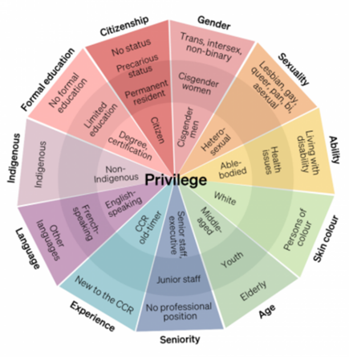
Wheel of privilege

Slide 6
Timeline
WP1
Stakeholder identification
Literature mapping
(Ongoing)
WP2
Surveys
Interviews
(August – November
2024)
WP3
Focus Groups
(November 2024 – February
2025)
–
WP4
Outputs
Tool design
(February – April
2025)
Stakeholder Engagement event
(February 2025)

Slide 7
Participants: 276
Online on Qualtrics
Demographics
Gender: 48% male, 52% female
Education: College – Master’s degree
Mean age: 46.38
Familiarity with science: Slightly – Moderately familiar

Slide 8
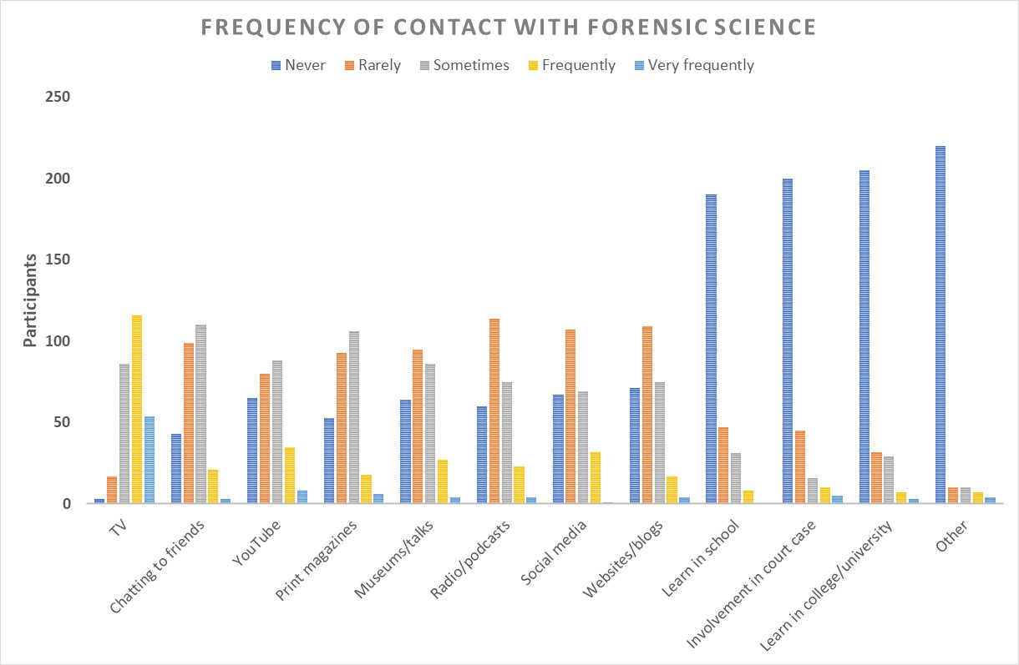
Table
Survey Findings
Source | Mean Score
TV | 3.73
Chatting to friends | 2.43
YouTube/similar | 2.42
Print/mags | 2.39
Museums/talks | 2.32
Radio/podcasts | 2.26
Social media | 2.25
Websites/blogs | 2.18
School | 1.48
Involvement court case | 1.46
College/University | 1.45
Other | 1.15
Never = 1, Rarely = 2, Sometimes = 3, Frequently = 4, Very frequently = 5

Slide 9
Survey Findings
Familiarity with forensic techniques

Slide 10
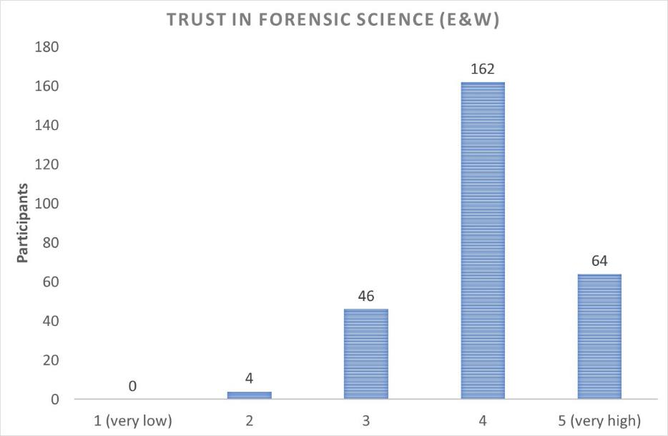
Survey Findings

Slide 11
Attitudes towards Forensic Science & Scientists
Survey Findings
4.42
Forensic science:
Reliable
Provides impartial evidence
Provides robust corroborating evidence
The benefits of forensic science are greater than potential damage
Forensic science improves the criminal justice
4 = somewhat agree
5 = strongly agree
Forensic Scientists expertise:
Have expertise in their particular topic
Qualified professionally
Do not stop striving for more knowledge
Give their expert opinion
Do not deal with matters outside of their area of expertise
Forensic scientists are competent
4.37
* Scores on all items collapsed into single score. Possible range 1.00 – 5.00

Slide 12
Forensic Scientists’ Transparency & Communication
Survey Findings
Forensic scientists' transparency:
Inform the public about the relevant results of their work
Explain scientific information in a common language that laypersons can understand
Cover up nothing about their work.
Disclose their work to the "other side" (prosecution/ defence) in a criminal trial.
3.67
3 = neither agree nor disagree
4 = somewhat agree
Forensic scientists' communication:
Value the ideas of the public, e.g., listen to what the public thinks about their work
Involve the public in their research.
Do not refuse to engage in conversations with citizens
Engage with the public in a way that raises awareness of forensic science processes
3.08
* Scores on all items collapsed into single score. Possible range 1.00 – 5.00

Slide 13
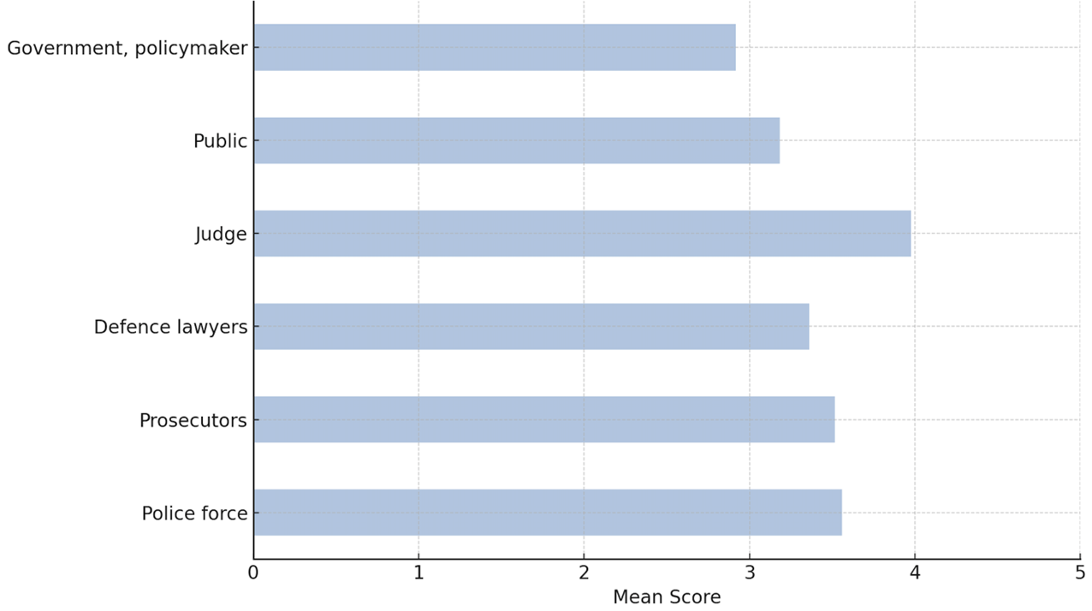
Trust in other stakeholders:
Survey Findings

Slide 14
Linguistic Survey
Participants: 500
Demographics: UK
Duration: 10-15 min
Online: Qualtrics

Slide 15
Communication affects trust - linguistic factors are important in understanding forensic science and its use for Digital and DNA evidence:
Our questions:
What to say - Lexical dialectology element with items commonly found in forensic analysis of digital and DNA evidence
How to say it - Voices judged according to traits (trustworthiness, intelligence, honesty, professionalism etc.)
Who says it - How something is described by CJS (forensic scientists, police etc) and interpreted by the public

Slide 16
Interviews
Participants: 32
Policing: 7
Academia: 12
Scientists/CSIs: 6
Lawyers: 4
Government: 3

Slide 17
Public Trust
Interviews Findings
Forensic Evidence
DNA evidence
Less trust in Digital evidence
Courts
Judges
forensic scientists
“from my experience of jury, they trust it [DNA] almost implicitly.” [P12]
“the trust is higher at courtroom because I think that people still hold a lot of trust for that judge.” [P32]

Slide 18
Public mis/dis - trust
Interviews Findings
“Trust is really low right across the board.” [P10]
Policing in general
“I don't think it's about the science. I think it's just around the sort of general sort of feeling of policing.” [P10]
Policing seen as the gatekeepers to the CJS
Negative attitudes towards policing
“I've had a really bad experience in the past. Either the police haven't turned up or it hasn't gone to court, so I'm not expecting much this time.” [P22]
Science
“I don't know whether it's specific to forensic science. I think there's a general mistrust of science.” [P19]
Government
“[FS] it's seen as another one of those things that can't really be trusted because it’s [a] government type thing.” [P18]

Slide 19
Marginalised groups' barriers to trust
Interviews Findings
“I find that sometimes victims, witnesses are really submissive to the police and will just give up their kind of clothing, give up their devices and just kind of give consent. Do they really know what's going to happen? Do they know where the damage might be caused to their clothing that we've seized? I'm less confident.” [P17]
Limited knowledge:
Policing, Forensic science, Rights
Limited access to information
e.g. older people, non-native speakers, etc.
Community hubs

Slide 20
Increasing trust
Interviews Findings
Public
Marginalised groups
Increase public knowledge of forensic science.
Communication
Forensic science
Procedures
Rights
Accessible information / Inclusivity
Language
Online/hardcopy material
Being proactive
“people kind of misunderstand forensic science and its interpretation and believe that it means something that maybe it doesn't. So I suppose they overstretch the importance of some results.” [P18]
Managing expectations about FS
Communication and Transparency
Increasing police awareness around FS, broader science, and tech in policing
“that requires us to be proactive, […] the information and the kind of confidence piece and building that up needs to come before they report crime.” [P18]

Slide 21
Challenges in increasing public trust
Interviews Findings
Lack of funding and staffing
Backlogs
“cutting corners”
Lack of research
Media
Forensic TV programmes
News
“As for policing, nothing positive comes out in the media, so you're never going to have on the front pages of a newspaper or like BBC News.” [P17]

Slide 22
Challenges in increasing MG trust
Interviews Findings
Negative experiences with the CJS.
Cultural barriers
Community hubs
Tuned memories
“people relate to people that they see. If you're not white and English or white and American, although they have some black people in the CSI series, then you’re potentially divorced from the process. ‘They're not like me. That is not like me. And maybe therefore, you know that science isn't for me either because it's more of a white person’.” [P18]
“We've created an English leaflet. […] How are we actually going to talk to people about it? Because you will do some social media posts, you'll go out and do events, but they're not accessible to those areas of community.” [P17]

Slide 23
Focus groups
Participants: 164
Interactions: 226
Locations:
Scotland (Glasgow, Fife, Perth, West Dumbartonshire)
London (North, South, East)

Slide 24
Focus Groups
Focus group Findings
Interactive element
Marginalised groups​
Trust in CJS​
Show videos of fictional crime scenarios ​
Use mentimeter to register anonymous opinions​
Group discussion
Scottish Drug Support Organisation ​
Women's Domestic Abuse/Mental Health Support Organisation (Black and Asian Women​
Under 18s​
University – non-traditional students
Their own experiences influence their level of trust in the system​
We want to create a tool that helps to increase marginalised groups trust in the CJS​
More info and interactive experience this afternoon!

Slide 25
Citizen Engagement
Care to share
Public perspectives of trust towards criminal justice system practitioners (police, forensic scientists, CSIs)
Short videos with questions based around 10 scenarios Digital (5) and DNA (5) of different perceived ‘seriousness’

Slide 26
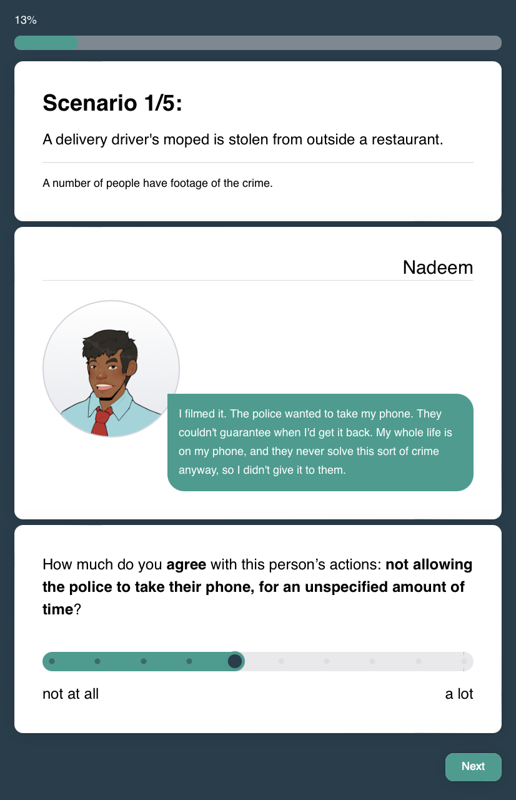
Example of scenarios
Example of questions

Slide 27
Thank you
Dr Violeta Kapageorgiadou
violeta.kapageorgiadou@open.ac.uk
Dr Clair Dempsey
clair.dempsey@open.ac.uk
Website

