Slide 1
Widening access as a University of Sanctuary
Supporting those seeking sanctuary in Wales

Slide 2
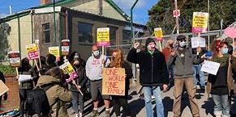
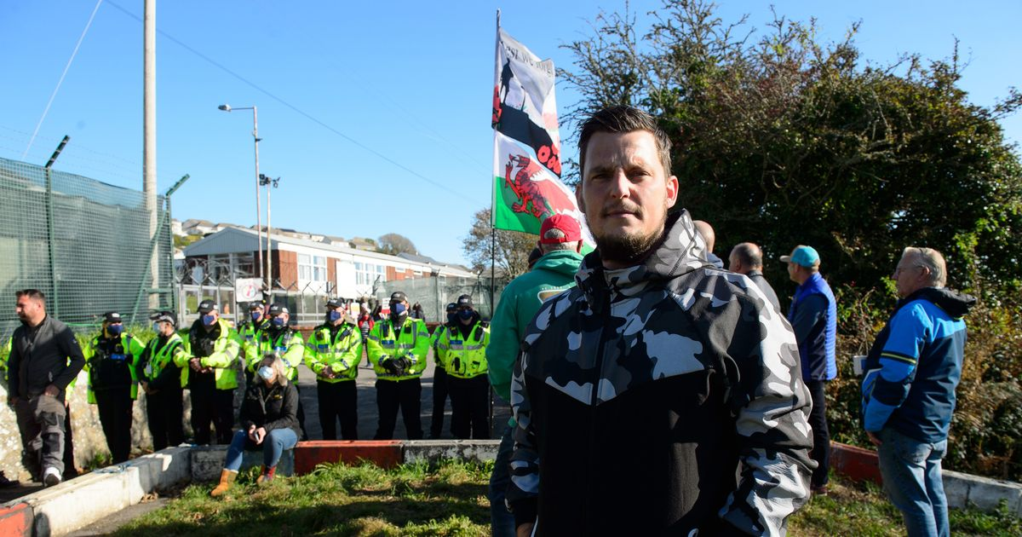
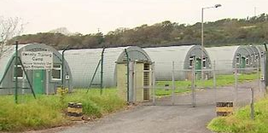
A Nation of Sanctuary
“The decision to use the Penally camp has undermined our ability to implement an effective migrant integration policy, as set out in our Nation of Sanctuary plan.”
Welsh Government 2021

Slide 3
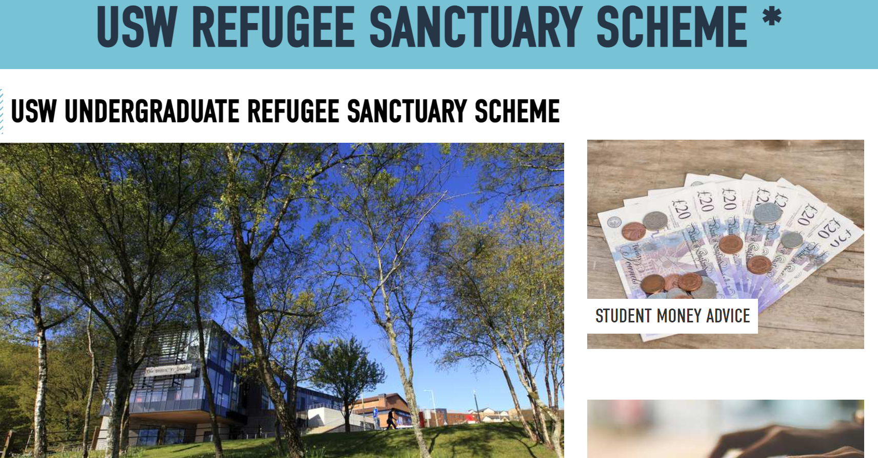
Supporting people seeking sanctuary
Notes:
Also in 2019, the University of Sanctuary sub-group was formed. This team, comprising academic and administrative staff from across the university, with formal terms of reference and identified meetings, is now a recognised sub-group of the University’s Equality and Diversity Steering Group (EDSG) which reports directly to the University’s Academic Board. This development has meant that issues surrounding access to university and support for forced migrant students are now embedded within the University’s formal reporting structure. Forced migrant students, in effect, have a voice.

Slide 4
USW recognized as a University of Sanctuary
Notes:
University of Sanctuary Action Plan – that sets out actions which relate to the sort of areas laid out in WG Refugee and AS plan and also the recommendations made by the University of Sanctuary awarding committee. As a reminder these include issues such as promoting access to HE on all courses and awards, ensuring support mechanisms are in place for this vulnerable group, and collaborating where possible to ensure the widening of access.
Action points include
Staff Training – PAC
STAR society reinvigorated
Introduction of mentoring / buddying system
Refugee Week educational activities
Staff Community of expertise research group on migration and displacement

Slide 5
The importance of HE study
“Getting the scholarship has made me feel that I will achieve my goal! I now study Computer Sciences. This (the scholarship) gives me the chance to develop my knowledge and my skills, and to be able to survive in the society that I am living in.”
(Sanctuary Scheme scholar)

