Slide 1
City of Sanctuary UK
Contributing to the movement by promoting a culture of welcome
https://cityofsanctuary.org/

Slide 2
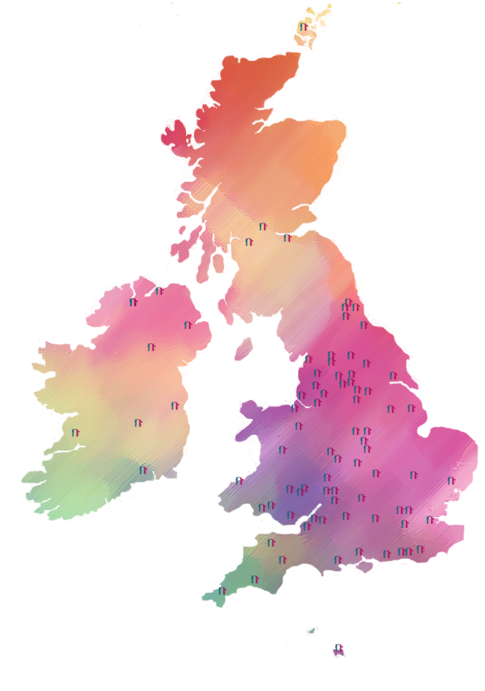
Who we are?
115+ local City of Sanctuary groups across the UK
These include towns, cities, villages, boroughs and communities of sanctuary
Streams of Sanctuary - Schools, Universities, Colleges, Libraries, Theatres etc of Sanctuary
CoS Local Authority Network
Notes:
Starting point is CoS Charter which describes what CoS is and what it does,
Simple vision – that vision of welcome for all. Vision - ‘The UK will be a welcoming place of safety for all and proud to offer sanctuary to people fleeing violence and persecution
In Wales we are working towards the vision of Wales as a Nation of Sanctuary.
What is slightly more complex is that CoS e are a movement, network and CoS UK - In other words:
City of Sanctuary UK is an organisation, which supports a UK-wide network of local groups and streams of work, which forms part of a much wider movement of organisations and individuals working in different ways to make the UK a welcoming place for people seeking sanctuary.
Where have we come from? Brief Story of CoS – Hundred Thousand welcomes
Started in 2005 Sheffield – 2007 Sheffield became our first CoS with over 70 pledged organisations and City Council support – slow but steady growth dispersal cities over the next few years. Then Swansea – first in Wales, second in UK.
Movement moments – Summer 2015 in response to the Syrian War and loss of life of people trying to cross the Mediteeraen – grow in towns, villiges from 20 to 50. 2017 we had around 80 – steady growth to date now 115 plus (with only a small number of groups becoming totally inactive)- But what we have seen is an explosion in our streams and awards work - 308 schools in total in 2020 - 19 universities in total in 2020 with around 40 others at various stages in the process. Back last year decision to no longer have city-wide recognition process but an Council of Sanctuary award – and supported by a network. It is probably worth noting that we probably time to recognitin that we are part of one big CoS network but within that there are numerous other networks such as schools, universities – at UK, regional, national in terms of the devolved nations and smaller local networks. .

Slide 3
How can we achieve our vision?
Through practical application of our values and network principles
Contact theory - building relationships of solidarity
Movement Building - engaging mainstream through Streams of Sanctuary & Sanctuary Awards
Notes:
Well essentially we think by applying our network principles to all parts of CoS we can achieve changes we want to see - slightly more complex than that and in developing our strategy in 2017 we noted there are two parts to our theory of change.
At micro level we believe that the welcoming work that you are all doing at a grassroots level will change public attitudes towards sanctuary seekers – and most importantly we think that is most effectively done by applying our network principles and in particular through Creating opportunities for relationships of friendship and solidarity between local people and those seeking sanctuary – there is a lot of academic research both on public attitudes and in relation to social contact theory that underpins our assumptions in this regard.
And then both at micro level and macro level we are all contributing to building a wider movement – groups are building a network of pledged organisations, groups and CoS UK are working to make as many places as possible welcoming places of sanctuary, we are working to get more UK level mass membership organisations on board – so a bottom up and top down two pronged attack – and in doing so getting more and more individuals involved in the movement who call for change in the asylum system. Some the academic literature points to a tipping point of 3.5% of the population for movement building to create longer term change.
However what connects our welcoming work and our work to build a movement – what needs to happen to make the change we want – the UK to be a welcoming place of safety for all and proud to offer sanctuary to those fleeing violence and persecution

Slide 4
Streams & Sanctuary Awards
Streams – Schools, Universities, Colleges, Libraries, Arts
Awards – recognition for exemplary work
Notes:
Streams and Awards are strategic tools for movement building - A Stream of Sanctuary encourages professionals or practitioners within ‘communities of practices or interests’ to come together to embed the concepts of welcome, safety and inclusion within their professions, sectors and organisations, together with other interested individuals (including people seeking sanctuary), groups and organisations.
Any individual or organisation working within a Stream of Sanctuary must be committed to the vision and values of City of Sanctuary. The development of new activities, projects and initiatives within a Stream must be aligned with City of Sanctuary network principles. A Stream will also enable the sharing of best practice, resources and ideas.
Organisations that fall within a Stream of Sanctuary may wish to apply for a Sanctuary Award to gain recognition for the exemplary work - following specific criteria which have been developed by City of Sanctuary UK.

Slide 5
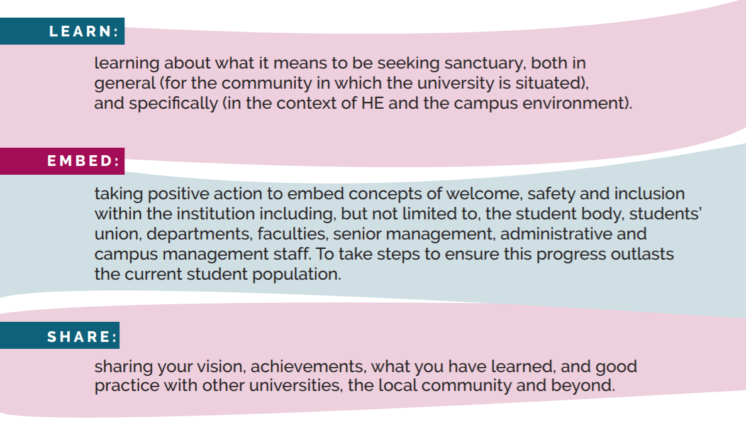
Award Process
LEARN, EMBED, SHARE
Notes:
Minimum criteria

Slide 6
The University of Sanctuary Network
STEERING GROUP
RESOURCES
EVENTS
CONNECTIONS
AWARDS
UoS Coordinator
STAR Equal Access
Researchers
Sanctuary Scholars
HE staff
Article 26
UoS Resource Pack
UOS website: resources and links
STAR Equal Access
Mailings & updates
Webinars
Gatherings
Annual Conference: was online in 2020 with 400 sign-ups
Sanctuary jiscmail listserve: SANCTUARY@ JISCMAIL.AC.UK
Introductions to colleagues & networks
21 awarded universities across the UK
A growing, collaborative network.

Slide 7
Reflections

